Slide 1

IMAGE-CAPTIONING
Team Silver: Yuwei Zhang, Dean Huang, Zihao Lin, Jeremy Zeng

Slide 2
WHY?
Automating generating interpretation of images.
Assistance for Visually Impaired
% of adult using social media: 2005 5% -- 2019 79%
How visually impaired people access social media?
Notes:
The % of adult in United States who were using social media regularly is only about 5% in 2005, but it dramatically increased to 79% in 2019.
But there are about 12 million people over the united state have vision impairment. So how this group people can enjoy the social media.

Slide 3
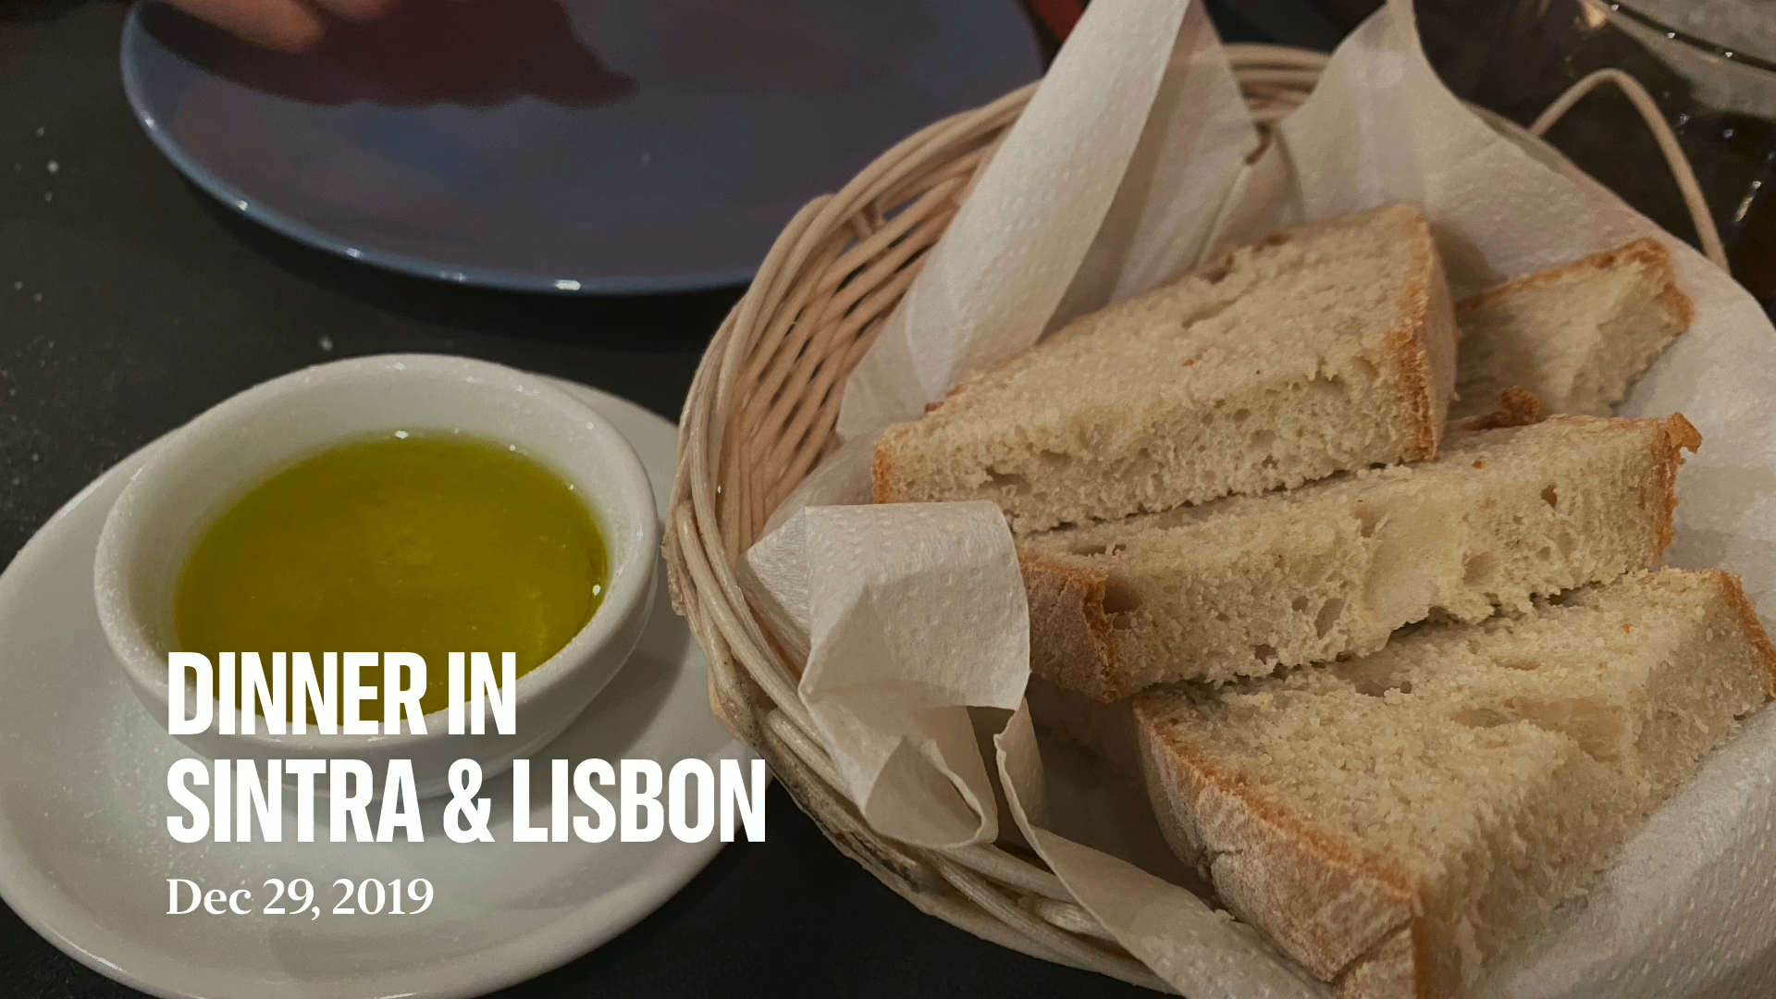
WHY?
Automating generating interpretation of images.
Assistance for Visually Impaired
% of adult using social media: 2005 5% -- 2019 79%
How visually impaired people access social media?
Notes:
With image caption generator, image descriptions can be read
out to visually impaired, enabling them to get a better sense of their surroundings. So that they can see the colorful and beautiful world like normal.

Slide 4
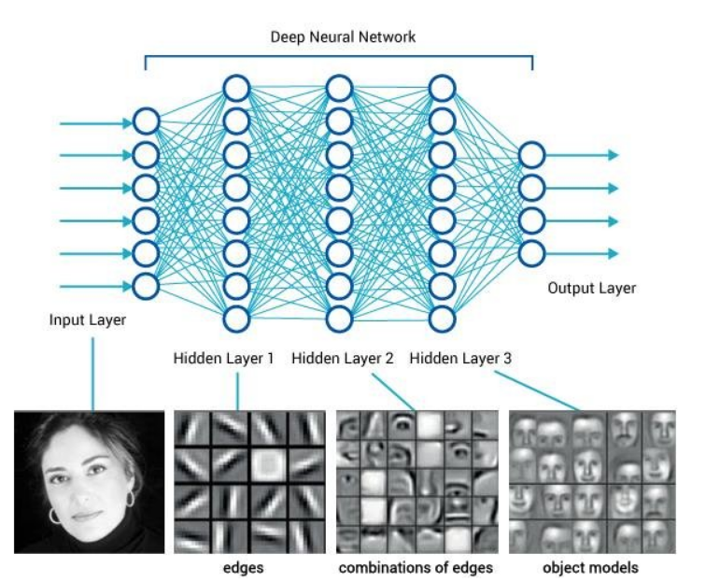
HOW?
Image Encoder
Notes:
Our image captioning models can be divided into two parts.
The First part is image encoder.
"The goal of CNN Image Encoder is to read the photograph input and encode the content into a fixed-length vector using an internal representation.The two image encoders we decided to implement are VGG and ResNet."
As illustrated, the first layer extracted edges and the third layer extracted the objects.

Slide 5
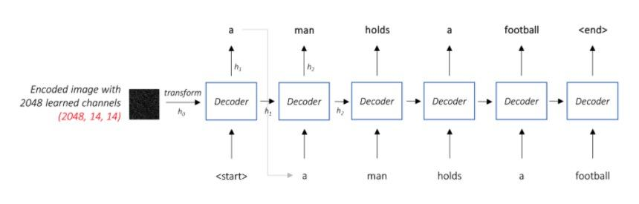
HOW?
Language Model
Notes:
"The goal of RNN Language Model is to extract the word features,
and forward the semantic temporal context to the recurrent layers.
As showed in the figure, the language decoder generates captions by decoding the multimodal space part maps generated by recurrent layers. And We will be using LSTM for our RNN Language Model.

Slide 6
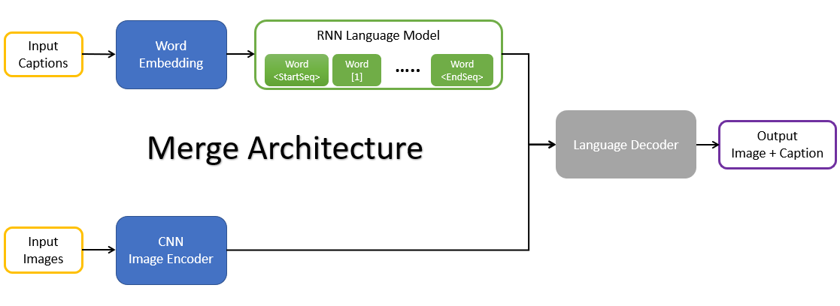
HOW?
Merge Architecture
Notes:
We implemented two different architecture for our project.
The first is merge
In this architecture the RNN is not exposed to the image vector at any point, and the image is only introduced to the language model after the prefix has been
encoded by the RNN in its entirety. This type of architecture allows the separate training of images and captions.

Slide 7
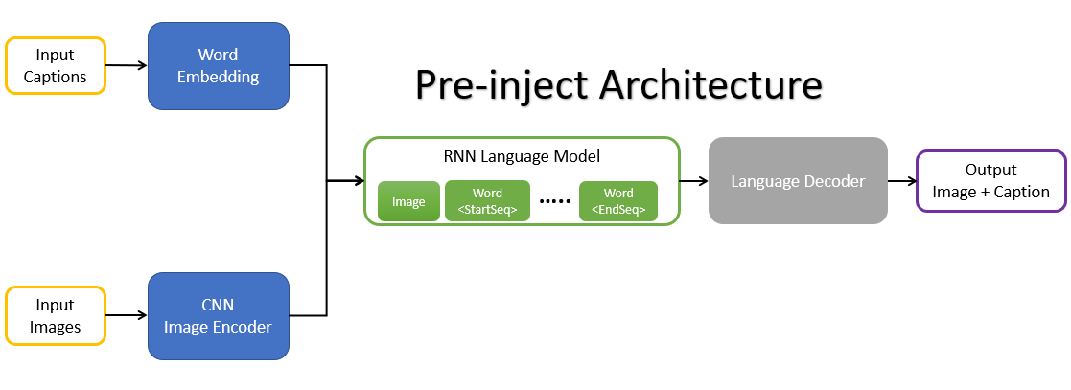
HOW?
Pre-inject Architecture
Attention
Beam Search
Notes:
The second architecture we applied is Pre-inject
The difference in this architecture the first input to the RNN is the image vector encoded by CNN with the word vectors of the caption prefix coming later
And we also added the Attention Network and Beam Search to optimize our language decoder.

Slide 8
BLEU
CIDEr
SPICE
bilingual evaluation understudy
Ref | I like the cat.
Can 1 | I like the fish.
Can 2 | I like eating hotdog.
BLEU-2:
can1: BLEU-2 = (I like) + (like the) / (I like) + (like the) + (the fish) = 2/3
can2: BLEU-2 = (I like) / (I like) + (like the) + (the fish) = 1/3
Notes:
Blue score measure the closeness of the machine generated text to the human reference text, and taking the text length, word choice and word order into consideration.
For example: we have ref I like the cat, can1, can2
blue score with bi-gram for can1

Slide 9
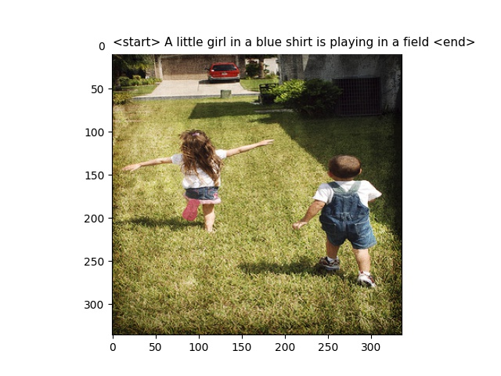
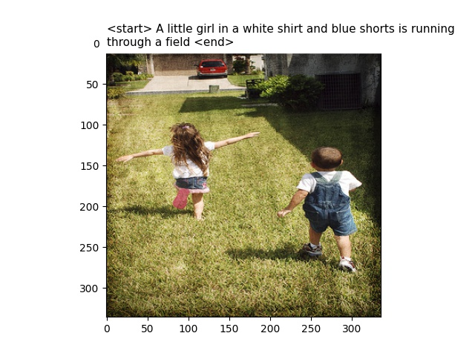
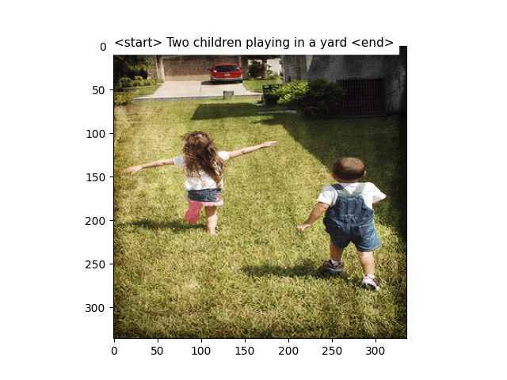
RESULT
Notes:
We applied our models at 3 stages from 2, 6, and 8 epochs to generate captions for the same images.
In this image, the model at 2 epoch captured a girl, but with blue and shirt mismatched.
At 6 epoch, the model could correctly match the shirt with white color and shorts with blue. It also recognized the running action.
The model gave us a surprise at 8 epoch, it not only correctly captured two children, but generated more abstract and human-like descriptions, which abstracted running actions into playing behaviors.
Generally speaking, the model captions grew from chaotic rough features to more organized and detailed descriptions, which are also more close to human words.
At the moment, the caption generated by the model is already very close to the human’s descriptions. We are still keep training it and looking forward to better performance of the model.

